Slide 1
DECISION TREE REGRESSION (CHAID)

Slide 2
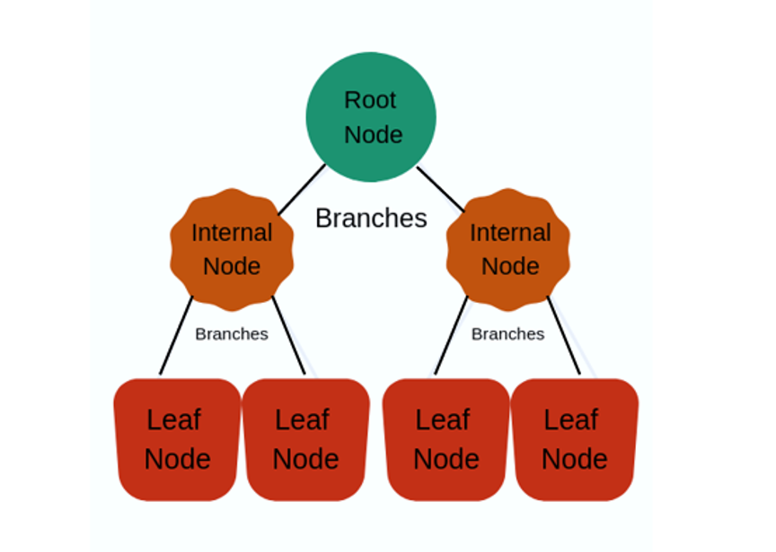
DECISION TREE
Decision Trees (DTs) are a non-parametric supervised learning method used for classification and regression. The goal is to create a model that predicts the value of a target variable by learning simple decision rules inferred from the data features.
A decision tree is a flowchart-like structure in which each internal node represents a "test" on an attribute, each branch represents the outcome of the test, and each leaf node represents a class label (decision taken after computing all attributes).

Slide 3
CHAID
CHAID (Chi-squared Automatic Interaction Detection) is a decision tree algorithm used for analyzing complex relationships between independent variables and a dependent variable.
It is used for both categorical and continuous independent variables and is based on the Chi-Square test for independence.
CHAID splits the data into homogeneous groups based on the independent variables and calculates the target (dependent) variable mean for each group.
If dependent variable is continuous we use F-test. The F-test is a statistical test used to determine if the means of two groups are equal.

Slide 4
ALGORITHM FRAMEWORK
Collect the data: A sample data set is collected that includes the independent variables (outlook, temperature, humidity, and wind) and the dependent variable (hours played).
Calculate the F-value for each predictor variable: The F-value for each predictor variable is calculated based on its correlation with the dependent variable. The variable with the highest F-value is chosen as the root node of the tree.
Partition the data into groups: The data is partitioned into groups based on the selected predictor variable. Each group represents a child node of the root node.
Calculate the mean value of the dependent variable for each group: The mean value of the dependent variable is calculated for each group, and this value is used as the predicted value for that group.

Slide 5
Perform an F-test: An F-test is performed to determine if the mean value of the dependent variable is significantly different between the groups created by the selected predictor variable.
Repeat the process: The process is repeated recursively on each child node, selecting the best predictor variable, partitioning the data, calculating the mean value of the dependent variable for each group, and performing an F-test, until a stopping criterion is met (e.g., minimum number of instances in a node, maximum tree depth, etc.).
TREE.xlsx

Slide 6
Advantages of CHAID (Chi-square Automatic Interaction Detector) Decision Tree Regression:
Simple and intuitive
Ability to handle non-linear relationships
Ability to handle categorical and continuous variables
Ability to handle missing values

Slide 7
Disadvantages of CHAID Decision Tree Regression:
Overfitting
Not suitable for large datasets
Prone to instability: small changes in data can result large changes in the structure of tree.

Slide 8
The disadvantages of CHAID Decision Tree Regression can be overcome by using various techniques such as:
Pruning
Ensemble methods
Regularization
Cross-validation
Feature selection

Slide 9
THANK YOU

